Slide 1
HL7 FHIR for CIMI (Fast Healthcare Interoperability Resources)
Grahame Grieve

Slide 2
Why FHIR?
No one is happy with current HL7 positioning
V2 old and tired
V3 ambitious and flawed
CDA limited and abused
Tsunami of interoperability coming
Fresh Look task force created CIMI
CIMI addresses an important need
But doesn’t address HL7’s problem: exchange of basic healthcare content

Slide 3
FHIR Genesis
If we were going to do something new now, how would we do it?
Look around – who’s doing interoperability well
Lots of roads lead to Highrise (37 Signals)
Adapt the HighRise specification (Resources For Healthcare)
HL7 liked that (a lot)
Prior to last meeting, much development + rename to FHIR

Slide 4
Who owns FHIR
Prior to last HL7 meeting, I owned it (© Health Intersections)
Now IP transferred to HL7
HL7 commits to making FHIR available for free
Exact license still to be determined
All hosted on HL7 servers
http://www.hl7.org/fhir

Slide 5
What is FHIR?
Fast Healthcare Interoperability Resources
Essentially HL7 v4
(won’t be marketed that way)
New artifacts
New methodology
New tools
New publishing approach
Still built on RIM, vocab & datatypes, but more hidden

Slide 6
FHIR Status
All development by a small team (3-4 people)
Yet to be balloted at all (for comment next cycle?)
Internal governance yet to be finalised (tbd in Vancouver)
Anything could change…

Slide 7
FHIR Basics
Build around the concept of “resources”
Small, discrete concepts that can be maintained independently
Clearly defined scope
Aligns with RESTful design philosophy
Each resource has a unique id
Resources are smallest units of transaction

Slide 8
FHIR Basics (cont’d)
Each resource is modeled using developer friendly XML
XML does not reflect RIM-based modeling
No classCodes, moodCodes, etc. visible
Strong ontology behind the scenes that does link to RIM and vocabulary
variant of the ISO data types – simplified, some changes due to different methodological constraints
Strong focus on simplicity
implementers do not need to know about the background methodology, but can leverage it if they want

Slide 9
RESTful Interfaces
Resources can be used with a simple RESTful interface
Predictable URL
HTTP based atomic transactions for CRUD Operations
Delete may not be honored and is not a true delete
Use with a RESTful framework is not required
Can aggregate resources into documents and send as a group
FHIR provides a classic event (v2) based messaging framework
Can use resources in custom services / SOA as desired

Slide 10
FHIR Basics (cont’d)
Built-in extension mechanism
Extensions are defined using name, value, link-point
Name is tied to robust terminology with full RIM modeling
Link point identifies what element of the base resource or other extension the extension “attaches” to
Idea is the elements used by 80% of implementers are part of the base resource.
All other elements are handled as extensions
Wire format remains stable, even as extensions occur

Slide 11
FHIR Basics (cont’d)
Full support for textual mark-up
In v3, only CDA provides for free-text mark-up for all elements. Messaging focuses on discrete data.
With FHIR, all resources, as well as all resource attributes have a free-text expression, an encoded expression or both
Conformance controls whether discrete data is required or not
Ensures that FHIR can support the human-readable interoperability delivered by CDA
Mark up is xhtml directly

Slide 12
FHIR premises
Design for the 80%, not 100%
Only include data elements in the artifacts if 80% of all implementers of that artifact will use the data element
Allow easy/stable extension for the remaining 20% of elements
which often make up 80% of current specs
Vocabulary approach to extension definition
Focus publication on documenting what the implementer needs, not what the modelers thought or designers need to remember

Slide 13
FHIR Products
Specification
UML diagrams
Schemas
Reference Implementations:
Java, C#, Delphi, more
Couch DB…
eCore implementation
OWL
Structured definitions

Slide 14
Resource representations
Each resource is published with several views covering different aspects
UML diagram
Simple pseudo-XML syntax
Vocabulary bindings
Notes
Search Criteria
Data dictionary
Example instance
Schema

Slide 15
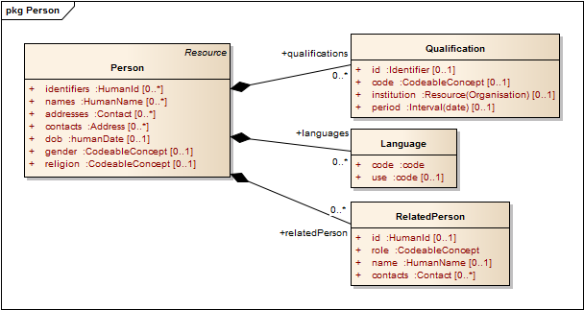
Example - Person

Slide 16
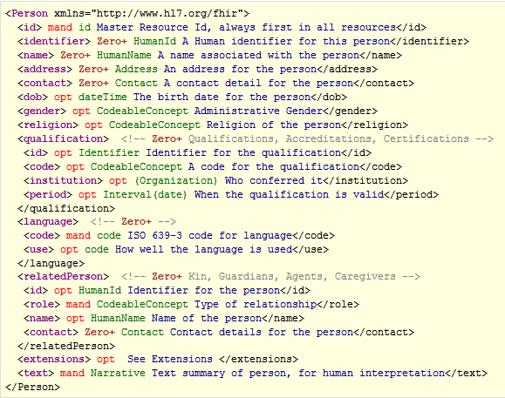
Example - Person

Slide 17
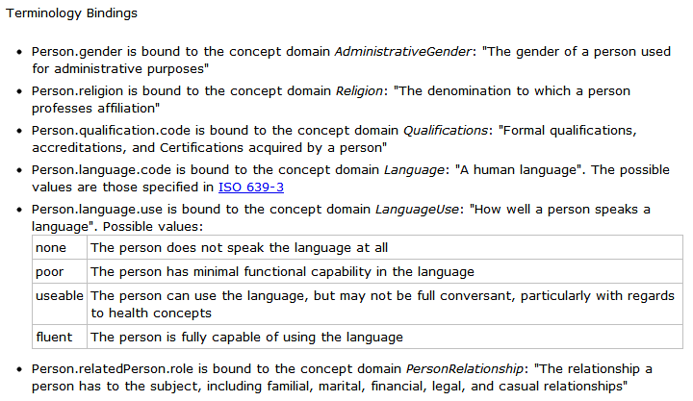
Example - Person

Slide 18
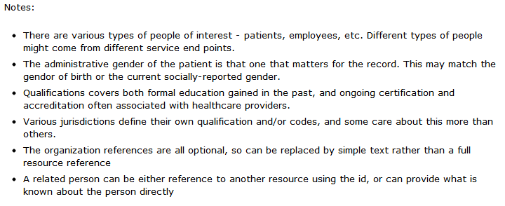
Example - Person

Slide 19
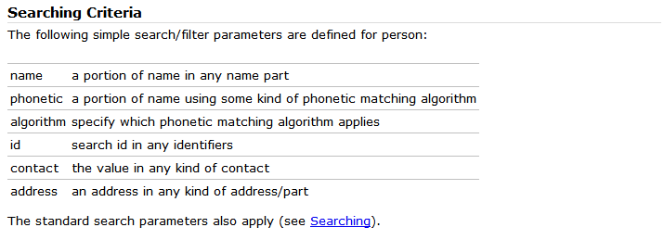
Example - Person

Slide 20
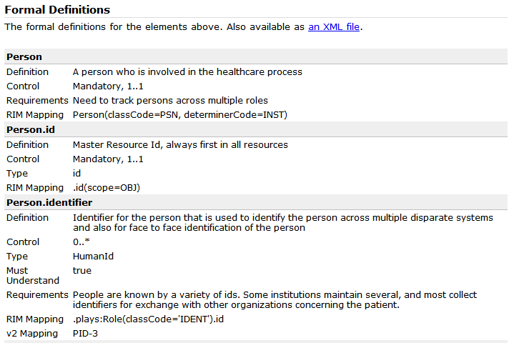
Example - Person

Slide 21
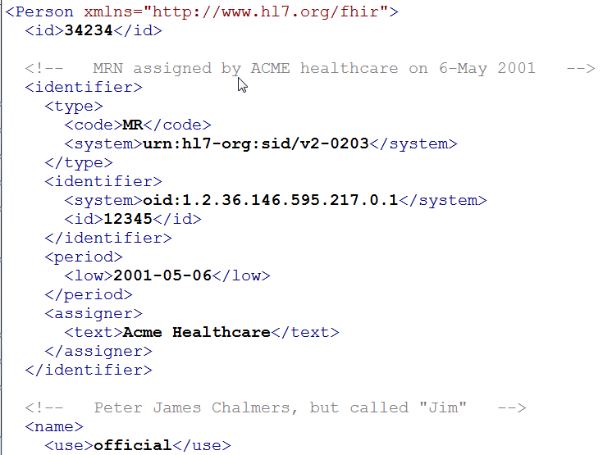
Example - Person

Slide 22
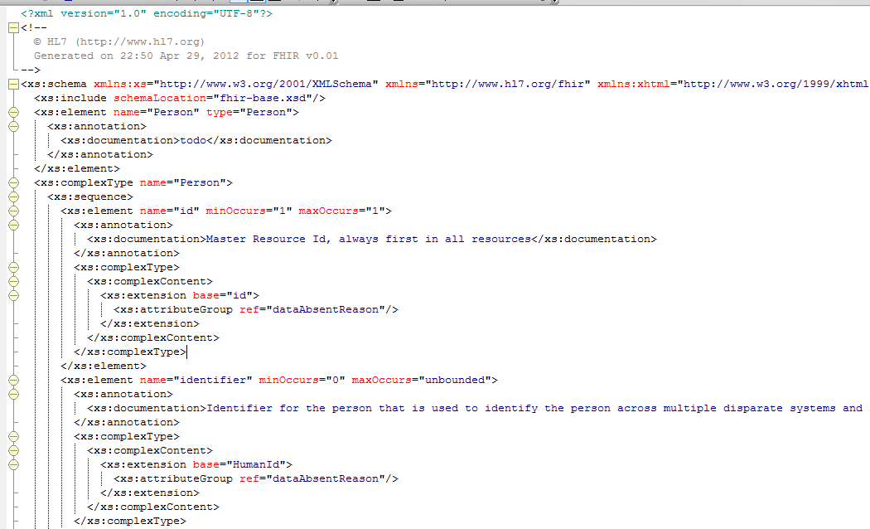
Example - Person

Slide 23
FHIR Resource Profile
A conformance profile: a statement of how a resource is used in a particular context
Describes constraints on resources (constraint)
Also describes what is added (extension)
Links to other resource profiles for resource references (composition)
A mash-up: building on top of the base resources
Multiple ways to author a resource profile
Should be interconvertible

Slide 24
FHIR and CIMI
FHIR and CIMI are very different things (scope, paradigm)
Multiple ways to relate:
FHIR could use CIMI definition framework in the background
FHIR could produce CIMI definitions as part of it’s products
CIMI could define clinical models as FHIR resource profiles (FHIR the way to deliver things)
Pursue independent paths (for now…) and see what works

